Slide 1
Lecture 9
The creation of scheme

Slide 2
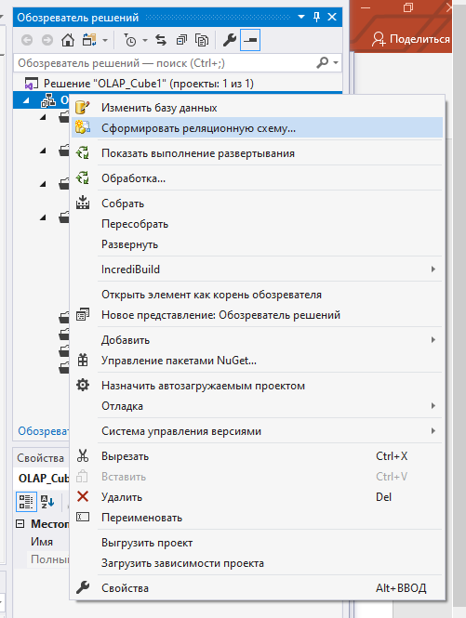
Creating a scheme of the diagram

Slide 3
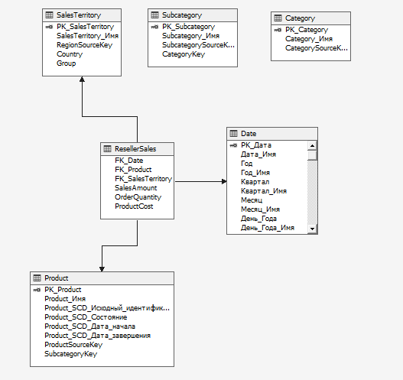
Creating a scheme of the diagram

Slide 4
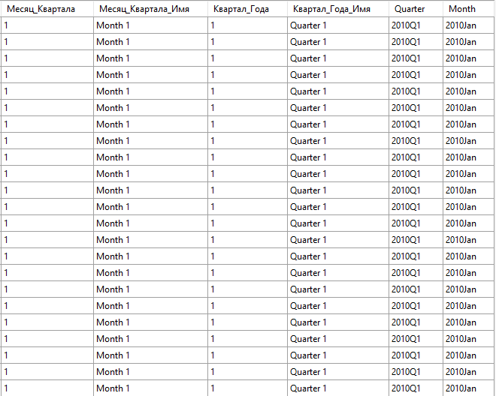
Adding named calculations
Let’s create a new Named calculation for Date table
convert(char(4), right(Год_Имя, 4)) + 'Q' + convert(char(1), Квартал_Года)
convert(char(4), right(Год_Имя, 4)) + ‘ ' + left(Месяц, 3)

Slide 5
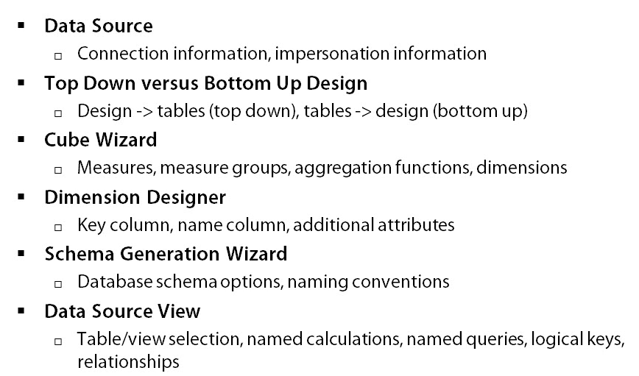
summary

